Slide 1
HC-SR501
Motion Sensor

Slide 2
INTRODUCTION
Proposed a home monitoring system to measure gas/smoke, temperature/humidity, and motion.
Selected to handle the motion sensor using the HC-SR501 sensor
Development Platform (Raspberry Pi B+)

Slide 3
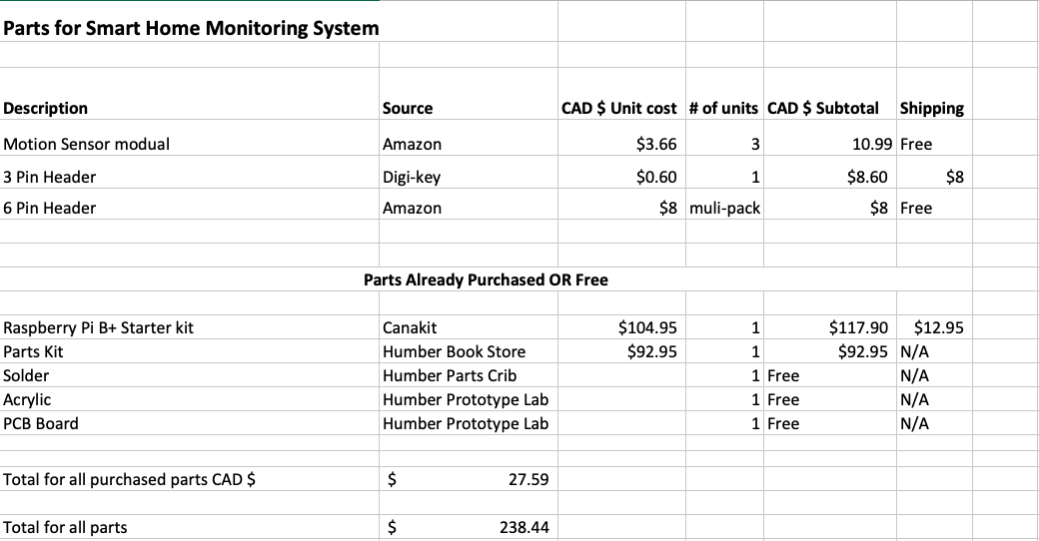
BUDGET

Slide 4
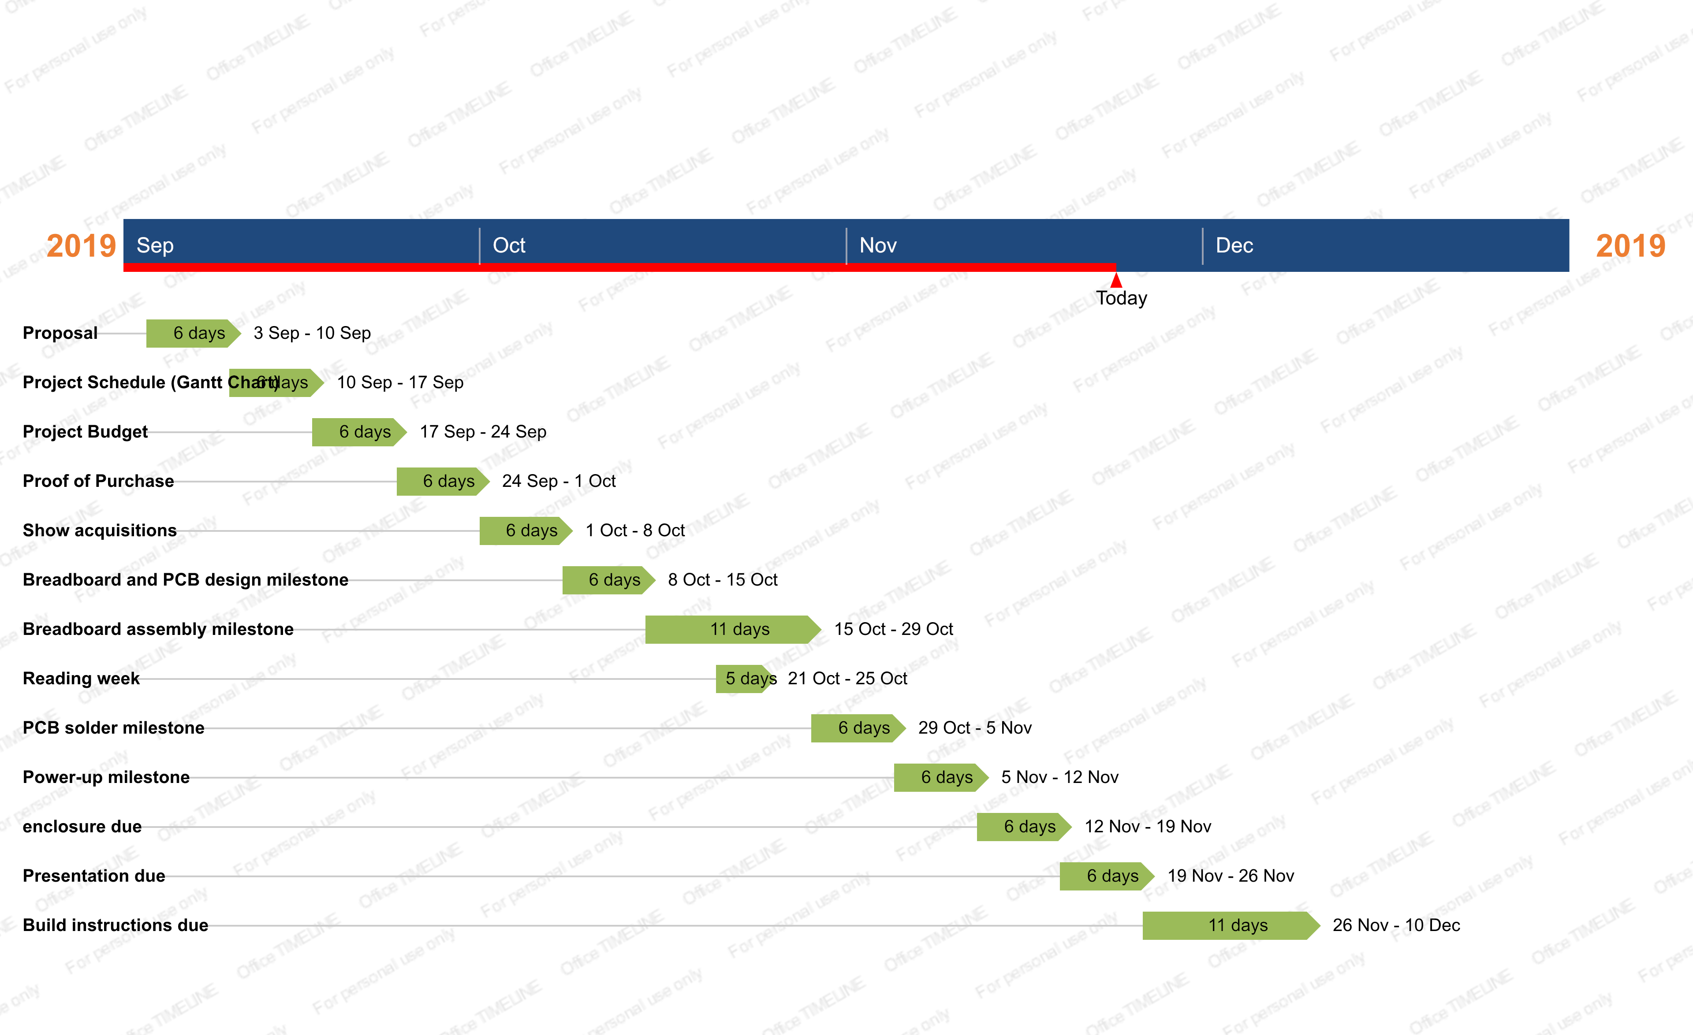

Slide 5
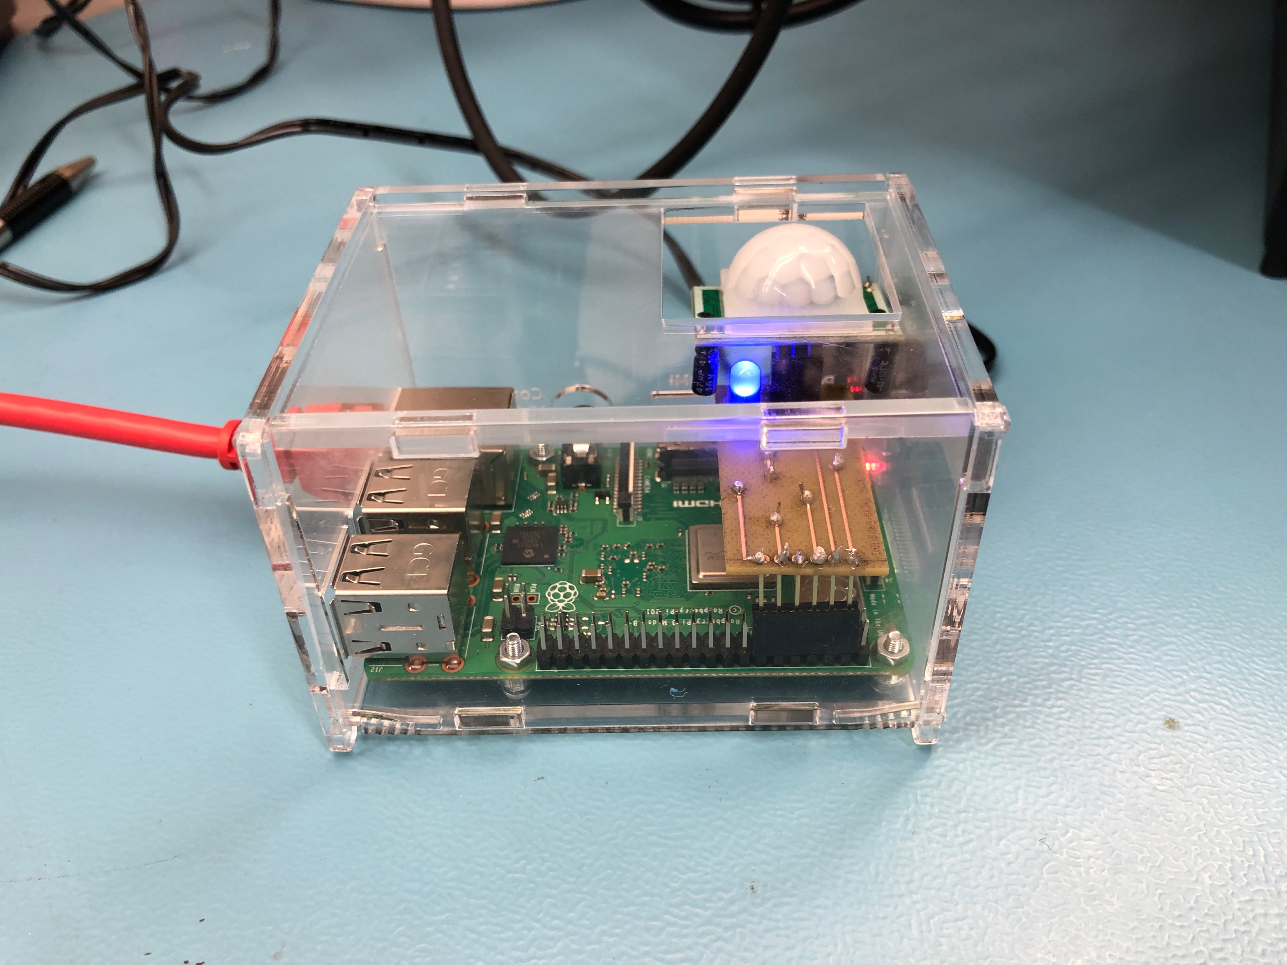
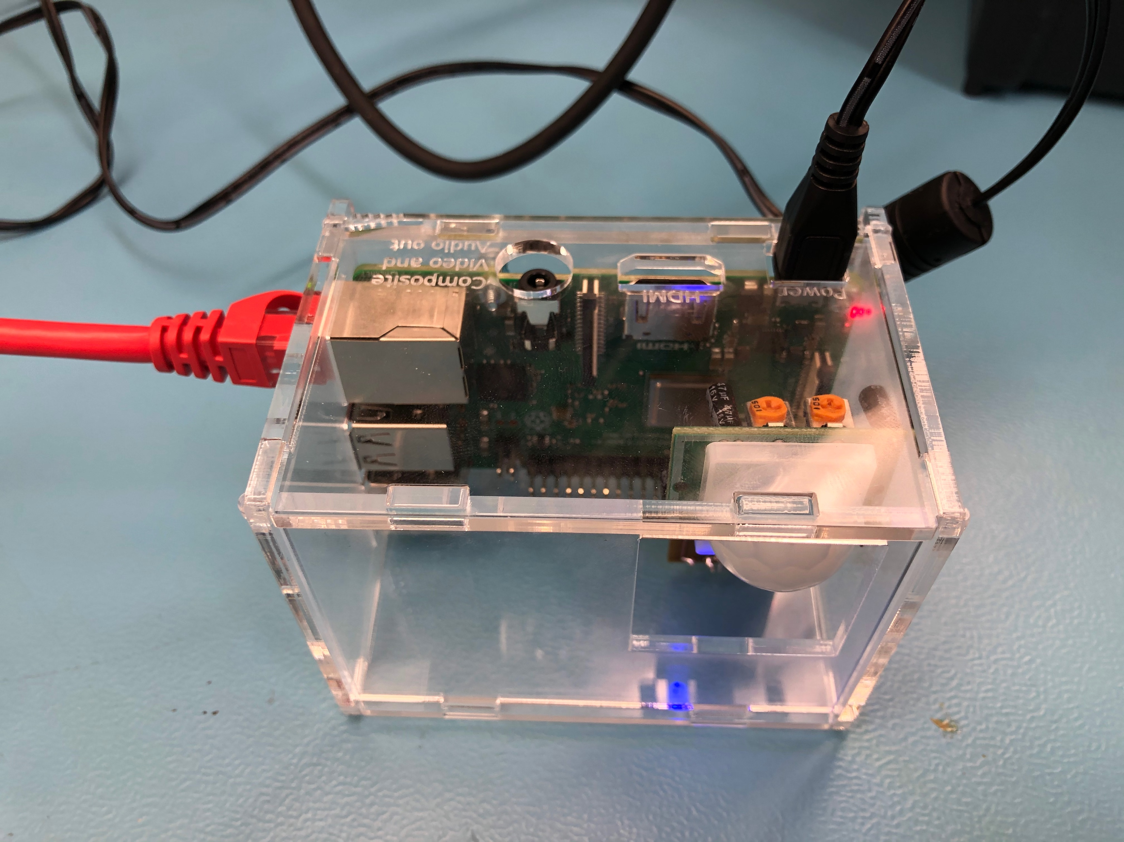
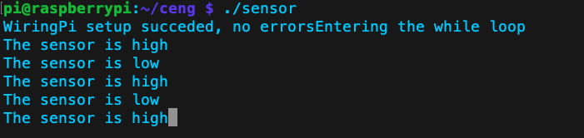
Enclosed Hardware

Slide 6
Knowledge utilized from previous courses
Embedded Systems: CENG-252
Connecting Raspberry Pi to VNC viewer
Technical C: TECH-151
Connected RaspberryPi to Terminal using USB to Ethernet adapter
Used the WiringPi library to read sensor data from RaspberryPi
Electric Circuits: TECH-101
Build circuit for breadboard and PCB milestones
Troubleshoot/ test before connecting it
Unix Scripting: CENG-200
navigate, create directories, compile, run code in UNIX environment
Intro to Software Engineering: CENG-216
Learned how to create Gantt charts, manage the development of projects
Waterfall VS Agile development

Slide 7
Knowledge utilized from previous courses
Unix Scripting: CENG-200
Learned how to navigate, create directories, compile, run code in UNIX environment
Intro to Software Engineering: CENG-216
Learned how to create Gantt charts, manage the development of projects
Waterfall VS Agile development

